Slide 1
2025
INVESTMENT PLANS

Slide 2
INTRODUCTION
The municipality of Edmundston plans to invest more than $25 million in capital projects in 2025.
The sources of funds are varied, and some are conditional: operating funds, loans, provincial and federal government contributions or other various agreements.

Slide 3
Setting the scene
In line with strategic planning
City Open and inclusive; Sustainable and prosper
To stimulate and sustain demographic growth to become a destination of choice
To stimulate and support economic development
To solidify, increase and diversify sources of revenue
To enrich community life
To improve environmental conditions in a sustainable way
To facilitate the accessibility and availability of information
To optimize efficiency in the delivery of municipal services
To maximize public engagement
To manage assets in a sustainable way

Slide 4
Context
An investment plan that focuses on diligent asset management
  Renewal of aging infrastructure and/or;
  Which contributes to increasing the lifespan of assets or;
  New asset acquisitions
Business as usual
  Sound debt/borrowing management
The Canadian Community Building Fund (CCBF - formerly the Gas Tax program), which we now know
  Amounts allocated in 2024 will be invested in 2025
Contribution of $6.2 million from operating budgets (all funds combined)

Slide 5
2025 Investments general fund

Slide 6
General Fund
 | General government services | $655,000
 | Protective services | $2,731,000
 | Environmental development services | $758,600
 | Recreation and cultural services | $2,394,000
 | Transportation services | $4,640,000
 | Total | $11,178,600

Slide 7

General Fund
General Government Services
Updating network and infrastructure equipment, VOIP, security cameras | $193,000
Edmundston Municipal Parking Garage - Door Security | $100,000
City Hall - Building - Generator, UPS and ventilation | $162,000
Convention Center - Building - different interventions | $200,000
Partial sum | $655,000

Slide 8
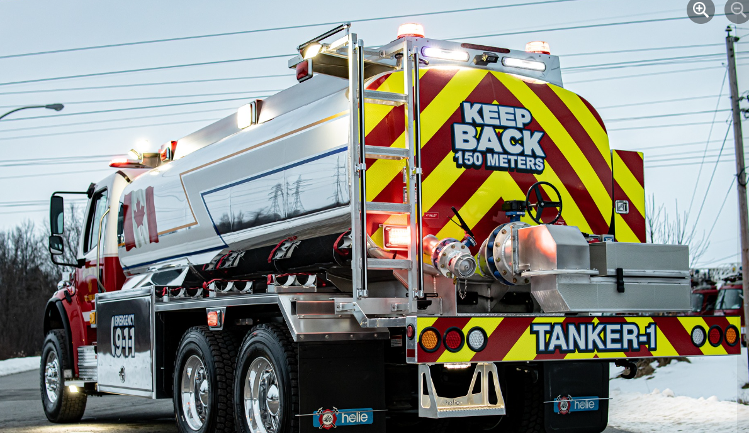
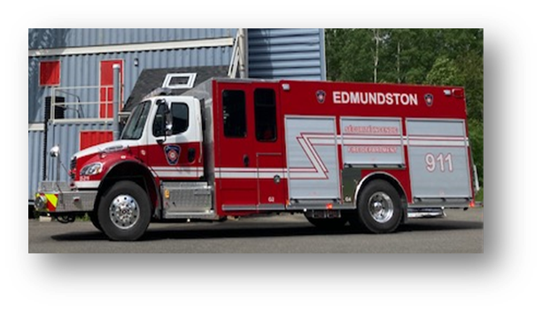
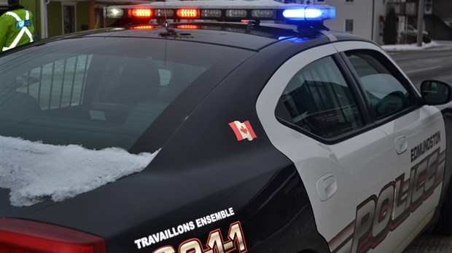
General Fund
Protective Services
Fire - heavy equipment - tanker and fire engine | $1,600,000
Fire - equipment renewal | $20,000
St-Jacques and Rivière-Verte fire stations (buildings - various interventions) / Preparing the site of the former fire station in St-Basile | $107,000
Police - equipment renewal | $20,000
Police - Various small wheels - 5 vehicles | $284,000
Police- Infrastructure preparation - Rental space | $700,000
Partial sum | $2,731,000

Slide 9
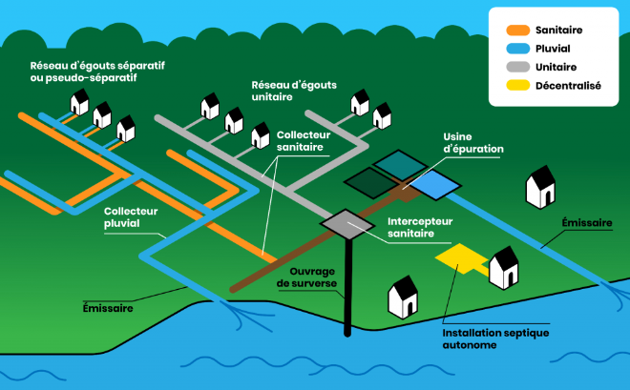
General Fund
Environmental Development Services
Community signage/signage/school corridors | $75,000
Purchase of land | $60,000
Various traffic studies / Edupole study / Guerrette Creek watershed assessment | $106,000
Housing Initiatives (includes land on Laboissonière Street - CMHC 35% 1.2M split with W&S) | $367,600
Stormwater management plan | $150,000
Partial sum | $758,600

Slide 10
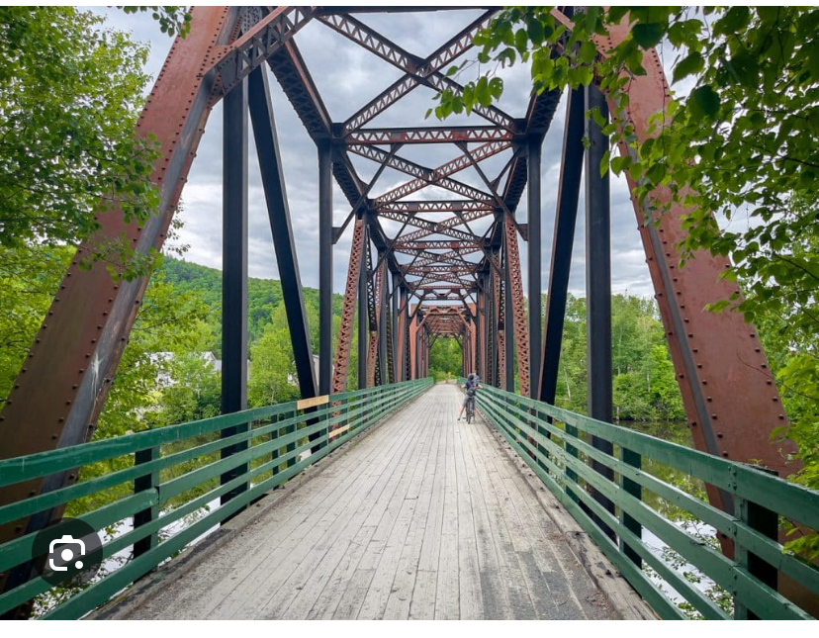
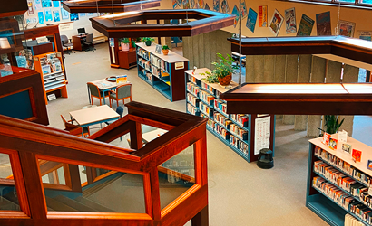
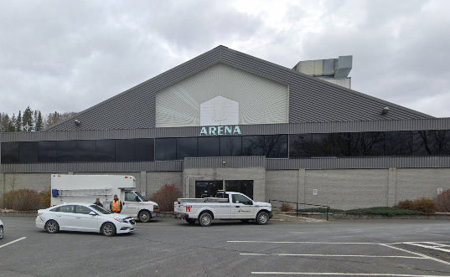
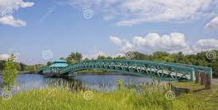
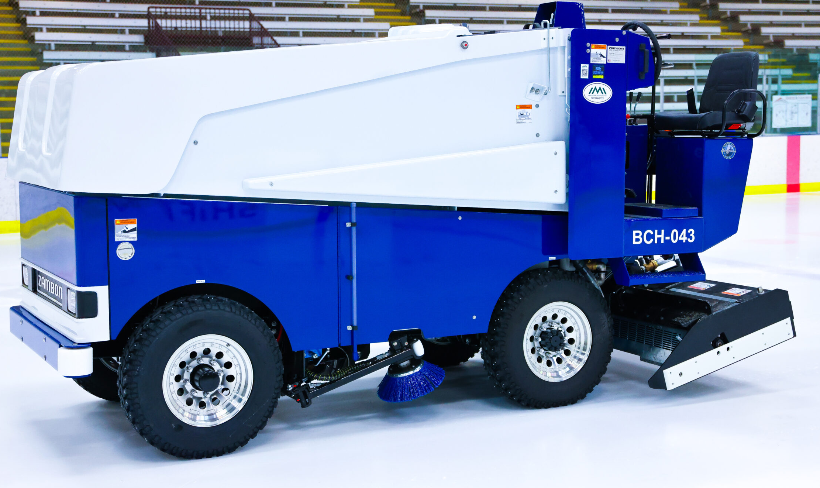
General Fund
Recreation and Cultural Services
Petit Temis Bridge - bike path (Madawaska River) | $100,000
Improvement of urban bike path network | $83,000
Leisure Equipment - Sports field cleaning machine | $15,000
Decorative lighting | $30,000
Mgr-W.-J.-Conway Library - Building - Windows and Ventilation | $650,000
Various municipal park buildings (Berceau Park and Lévio Clavette Center) | $37,000
Allée des Arts trails (former skatepark site) | $150,000
Petit-Sault Park / Bernard Valcourt Bridge (study) / Lion pool / Wharf improvements (marina) / Fortin du Ptit Sault | $380,000
Landscaping and improvements - Place Hôtel de Ville | $130,000
Palladium - Building (as per MCW plan) | $150,000
Technical functional plan for arena renovation | $75,000
Jean-Daigle Center, Energy efficiency and UPS batteries | $50,000
Sports Pavillon - (buildings) | $130,000
Various parks (including Richelieu Park) | $184,000
Turf tractor (for greens) - Golf Club | $70,000
Ice resurfacer (Ex: Zamboni) | $160,000
Partial sum | $2,394,000

Slide 11
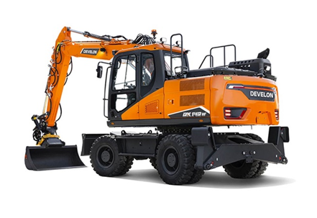
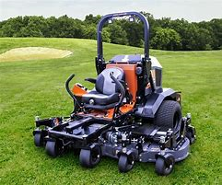
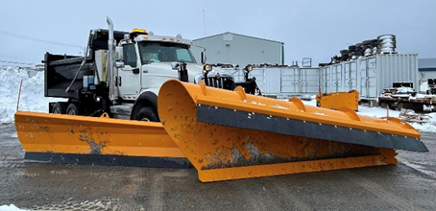
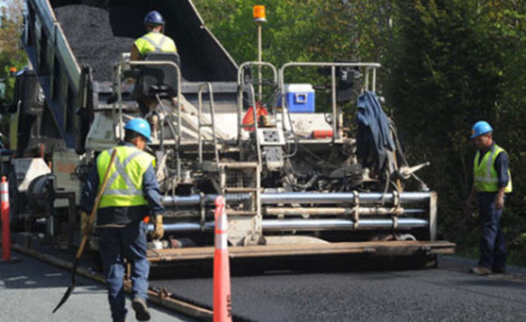
General Fund
Transportation services
Two Lawn tractors (Equipment & Accessories) | $90,000
Public Works Building | $75,000
Asset management: Study on specific assets | $25,000
Rehabilitation of municipal streets | $1,343,000
Paving of designated roads (conditional) | $1,730,000
Rehabilitation of sidewalks and retaining walls | $470,000
Renewal of traffic light and speed reduction control panels | $45,000
Downtown streetlights | $15,000
Small wheels | $45,000
Heavy equipment-Trucks | $378,000
Heavy equipment: Wheeled excavator with Tramac (to replace Backoe and Shovel) | $424,000
Partial sum | $4,640,000

Slide 12
General Fund
Summary of proposed funding sources
Long-term loans | $2,270,000
General operating fund | $3,200,000
CCBF 2024-2028 | $3,180,000
Government of Canada-CMHC | $40,000
Province of New Brunswick (RDC) | $327,600
Province of New Brunswick (DTI) | $1,251,000
Other revenues | $910,000
Total funds proposed | $11,178,600

Slide 13
2025 Investments
Water and wastewater DISPOSAL services fund – Edmundston

Slide 14
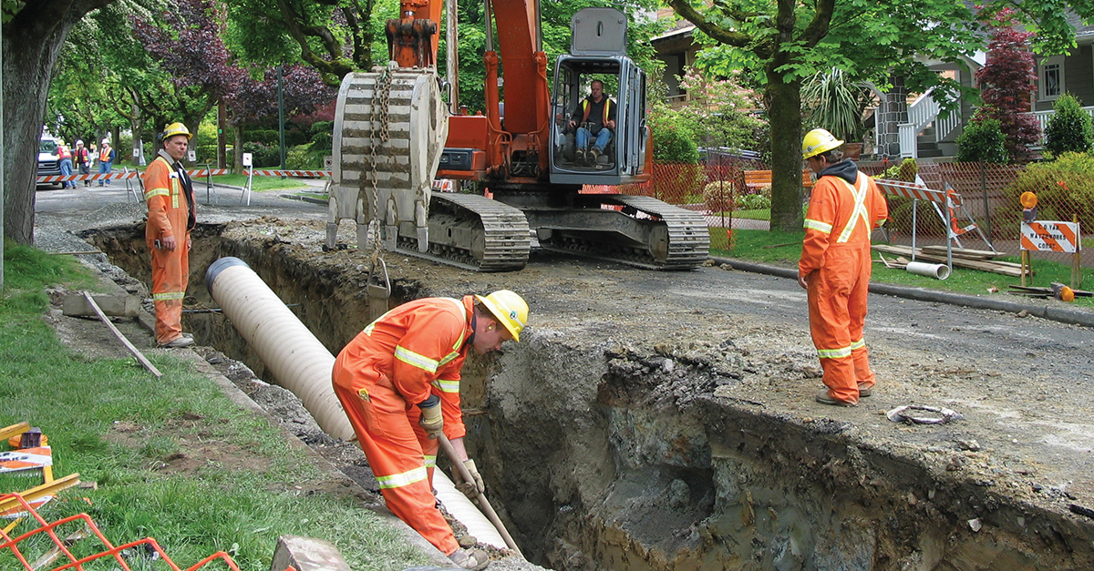
Water and wastewater disposal services fund
Water Service
Equipment including SCADA | $60,000
New services - Water (including distribution) | $145,000
Small wheels - water | $40,000
Engineering project - plans and specifications | $75,000
Water infrastructure development | $30,000
Rivière-Verte buildings and reservoir | $80,000
Richards Street extension - water | $541,200
Housing Initiatives CMHC (Water Infrastructures) | $1,047,885
Partial sum | $2,019,085

Slide 15
Water and wastewater disposal services fund
Wastewater Service
Pumping stations - Energy efficiency including Scada | $75,000
New services - Sanitary including pump renewal | $135,000
Small wheels - Costs | $50,000
Development - Sanitation sites | $25,000
Infrastructure Sanitary sewers (Voisine Steet) | $140,000
Richards Street extension - Sewers | $418,800
Housing Initiatives CMHC (Infrastructures Sewers) | $698,590
Partial sum | $1,542,390

Slide 16
Fonds des services d’eau et d’égouts
Summary of proposed funding sources
Long-term borrowings | $150,000
Water and wastewater services operating fund | $900,000
and wastewater services | $765,000
CCBF 2024-2028 | $982,075
Government of Canada-CMHC | $764,400
Total funds proposed | $3,561,475

Slide 17
2025 Investments
Generation facility fund

Slide 18
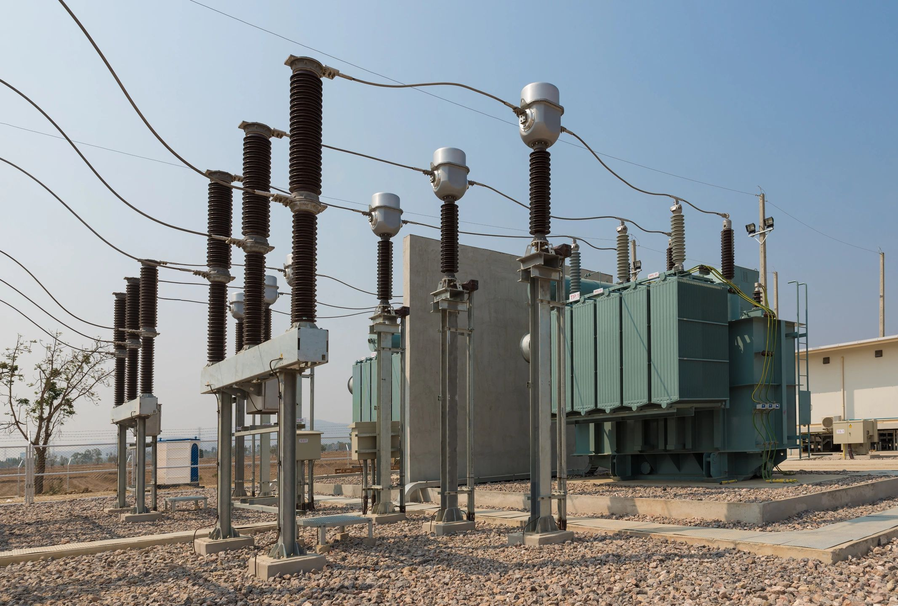
Generation facility fund
Generation facility fund
GRH turbine chamber 1 (Deuxième-Sault) | $325,000
Maintenance winch - Madawaska MRH2 generating station | $250,000
Renewal program / overhead infrastructure (materials)-poles | $200,000
New services (including meters and transformers) | $110,000
St-Basile substation (addition of a power transformer) | $10,000,000
Storage structure for wire and cable reels | $50,000
Partial sum | $10,935,390
Summary of proposed funding sources
Long-term loans | $7,500,000
Power generation operating fund | $1,935,000
Other income - Reserve | $1,500,000
Total funds proposed | $10,935,000

Slide 19
DEBT ratioS

Slide 20
DEBT RATIOS
Debt Ratio (projected) | 2024 | 2025
General Fund | 9,4 % | 8,5 %
Water and wastewater disposal services fund | 8,4 % | 6,6 %
Generation Fund | 8,5 % | 8,0 %

Slide 21
Conclusion
Recommendation to Municipal Council to approve investment plans for 2025..
Recommendation to Municipal Council to approve loan authorization requests for submission to the Municipal Capital Borrowing Board (MCBR).
  In order to receive confirmation of borrowing authorizations from the MCBR (decrees in Chamber).
Preparation, posting and resolutions (if any) of calls for tenders to plan the municipal (and contractual) crews' work schedule for next winter and spring.

